Slide 1




Connecting,
Collaborating
40 Years of…
and Innovating

Slide 2
Leveraging Machine Learning for Network Traffic Forecasting
Author,
Diane Onguetou, PhD
Independent Consultant
onguetou@umich.edu
Co-Author,
Achintha Maddumabandara, P. Eng.
Principal Data Analyst
Rogers Communications
Co-Author & Presenter,
Jeffrey Lee
Manager, Data Acquisition & Reporting
Rogers Communications

Slide 3
AGENDA
Introduction
Case study
The Network
The Dataset
CAGR approach
Global CAGR
Global vs. local CAGR estimates
Predictions from global vs. local CAGR
Machine Learning
Seasonal decomposition
Time series forecasting models
Time series vs. CAGR forecasting
Key Insights
Main improvements
Challenges when applying ML
Summary and recommendations

Slide 4
INTRODUCTION
Network Traffic Forecasting
Traffic analysis
[historical patterns, peak demand periods, seasonal variations]
Growth projections
Capacity planning
Performance optimization
Technology planning
Leveraging ML for Network Traffic Forecasting
Captures complex patterns and dynamics in the data, leading to more effective resource management and improved network performance
Automate iterative calculations and model attributes such as trends and seasonality, failure events, subsequent interactions between the primary and failover links, and network burst patterns
Computational power to scale the analysis of multiple variables and high granularity
Main Objective
Consider a large service provider network and sample traffic for 5 consecutive years
Analyzes traffic patterns in the first four years and use insights and findings to predict traffic in the fifth year

Slide 5
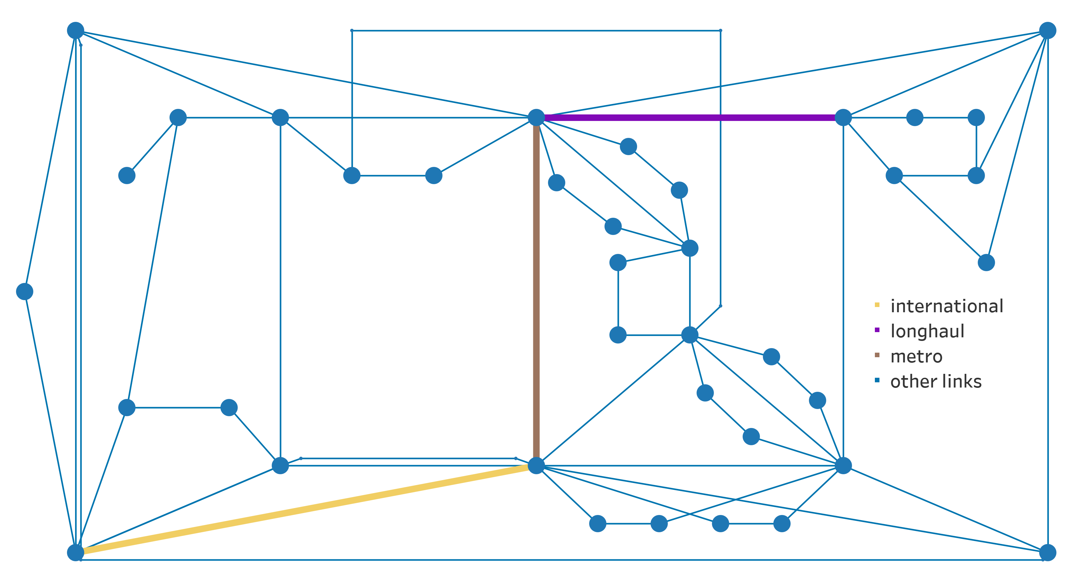
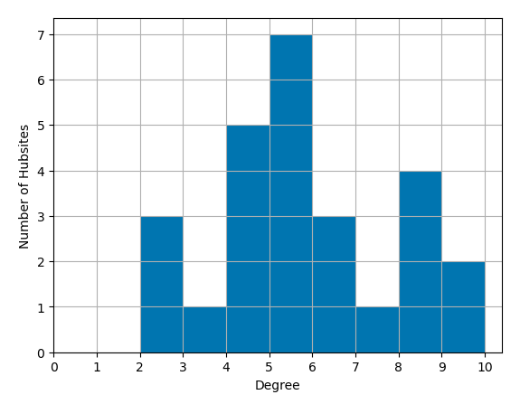
Distribution of Connectivity at a Hubsite
CASE STUDY – The Network
Logical View

Slide 6
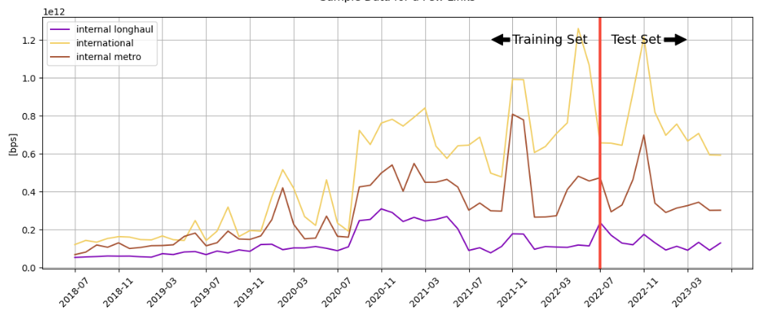
CASE STUDY – The Dataset
From daily max to monthly P95, for half of the network links
60 months of historical data, 48 for training and 12 for comparison, i.e. [80, 20]

Slide 7
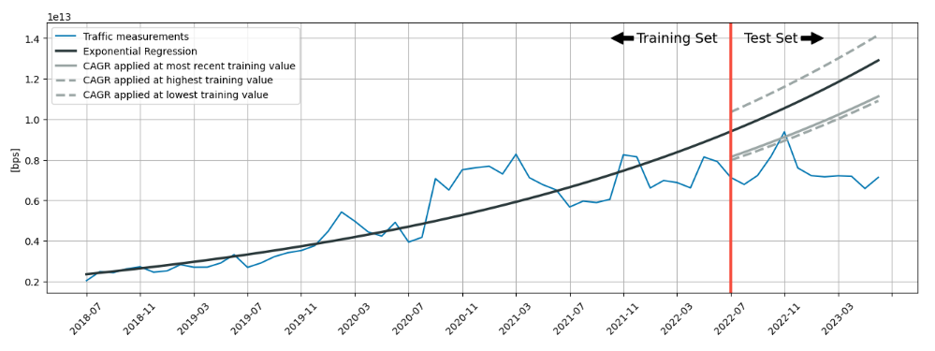
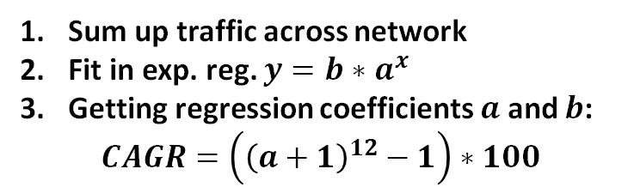
CAGR APPROACH TO NETWORK TRAFFIC FORECASTING
How to determine global CAGR?
Sum up traffic across network
Fit in exp. reg. $y={b∗a}^{x}$
Getting regression coefficients $a$ and $b$:
$$CAGR=\left({\left(a+1\right)}^{12}−1\right)∗100$$
Notes:
Add how you derive CAGR from exponential regression line

Slide 8
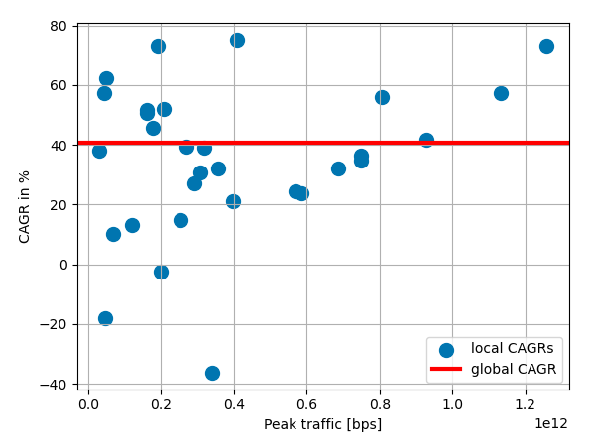
Limitations
CAGR APPROACH TO NETWORK TRAFFIC FORECASTING
Global vs. Local CAGR
Logic behind the choice of reference month
Most recent measurement on hands
vs. min/average/max over past 12 months
CAGR model accuracy
Applying a total-traffic CAGR to individual contributors
Global vs. local CAGR estimates
Predictions from global vs. local CAGR approaches (next slide)
2/3rd of local CAGRs are quite distant from global estimate

Slide 9
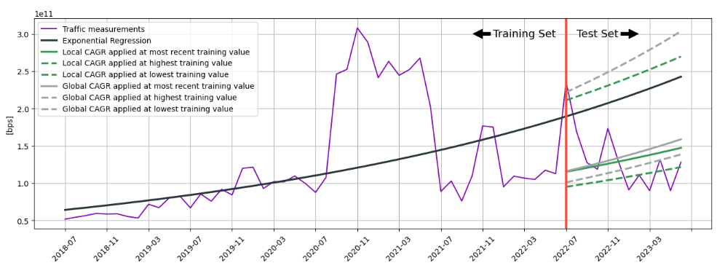
CAGR APPROACH TO NETWORK TRAFFIC FORECASTING
CAGR is sensitive to period choice.
Most of the time, local CAGR provides a better performance

Slide 10
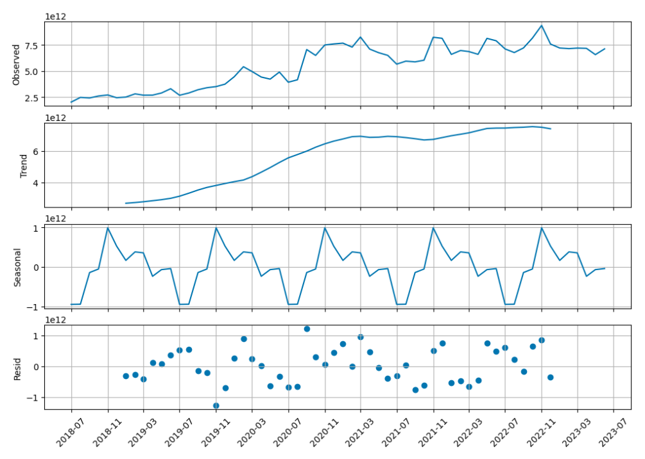
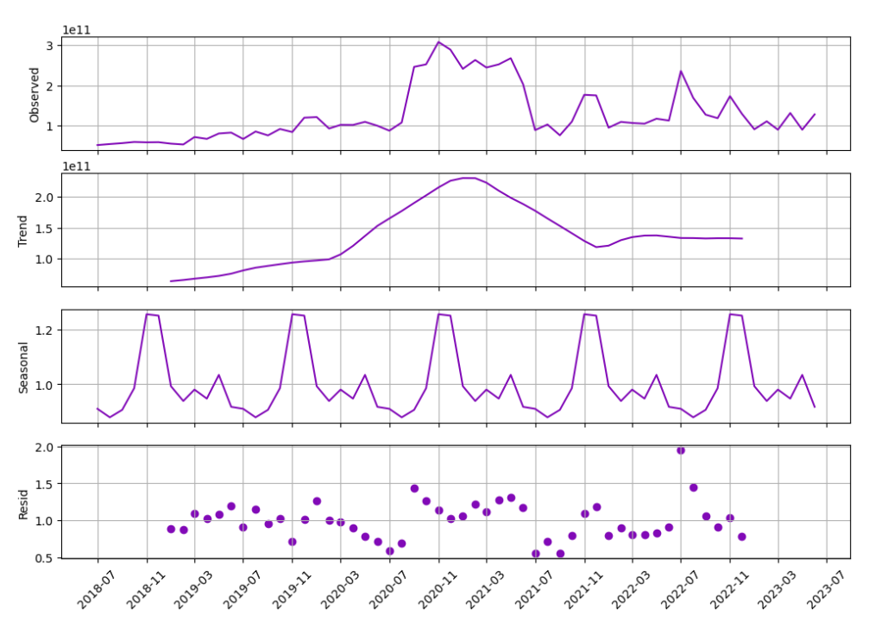
Example of Internal Longhaul Link (multiplicative)
ML | Seasonal Decomposition
Total Traffic
(additive decomposition)

Slide 11
ML | Example of Time Series Forecasting Models
Seasonal Decomposition (STL)
Breaks down a time series data into its fundamental components (i.e. trend, seasonality, and residual) to better understand underlying patterns
Seasonal autoregressive integrated moving average (SARIMA)
Combines autoregressive, differencing, and moving average components along with seasonal components to handle data with both non-seasonal and seasonal patterns
Holt-Winters/Exponential Smoothing (ETS)
Uses weighted average of past observations to predict future values, considering trend, seasonality, and level components to make accurate predictions for time series data

Slide 12
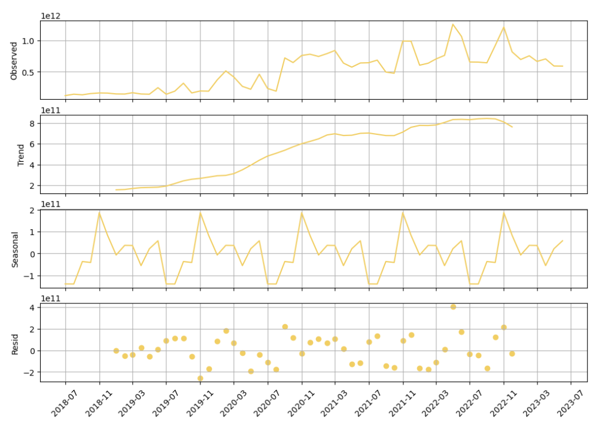
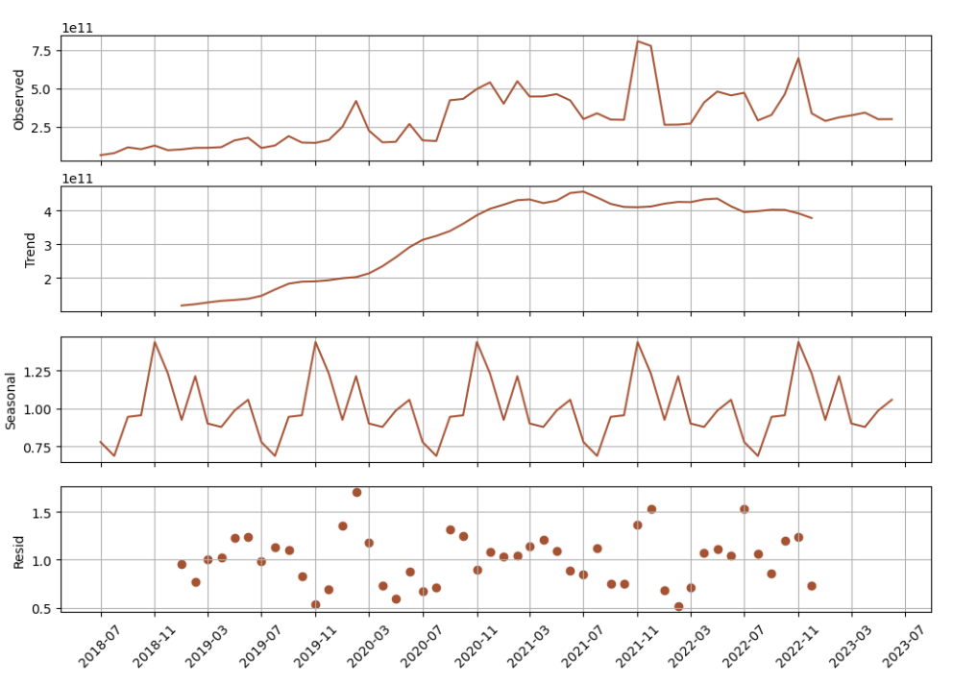
Example of Internal Metro Link (multiplicative)
ML | Seasonal Decomposition
Example of International Link (additive)

Slide 13
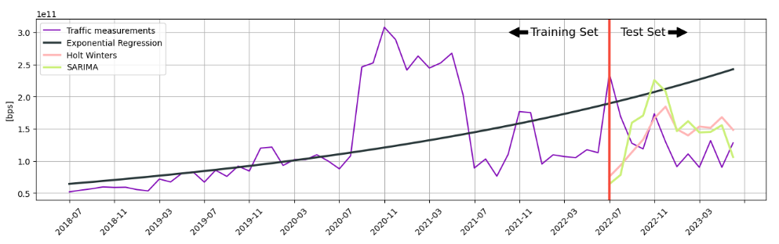
ML | Time Series Forecasting Models [longhaul link]
Holt-Winters has the best performance here
SARIMA seems to simply shift and repeat previous behavior, but still better than exp. reg.

Slide 14
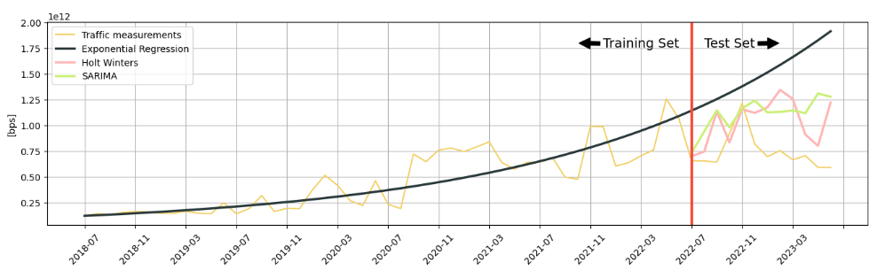
ML | Time Series Forecasting Models [international link]
Holt-Winters and SARIMA seem to show an equivalent performance here
Exp. reg. still has the worst performance

Slide 15
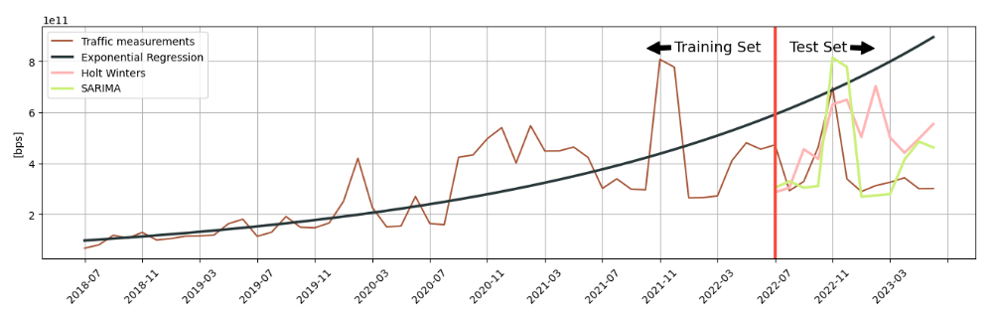
ML | Time Series Forecasting Models [metro link]
Holt-Winters better and more consistently across links
SARIMA seems to simply shift and repeat previous behavior, most of the time still better than exp. reg.

Slide 16
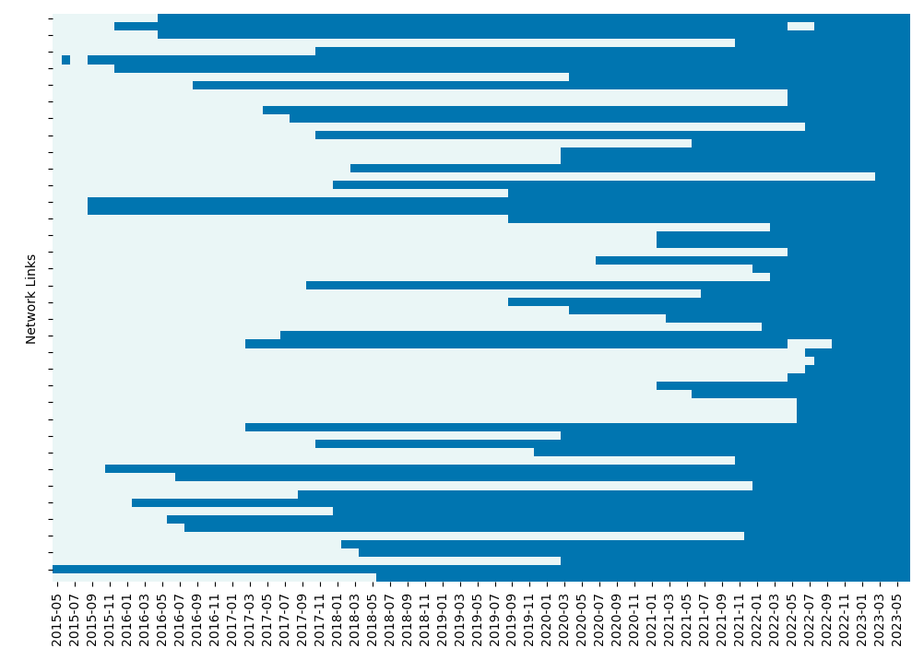
CHALLENGES WHEN ADOPTING ML-BASED TRAFFIC MODELLING
Access to clean dataset is our biggest challenge!!!
Forced to do an [80,20] where the ideal is [90,10] for training and test sets

Slide 17
KEY INSIGHTS
Good practices
Invest in quality datasets
Choose models appropriate to your needs
Re-evaluate models in a regular basis and track your progress
If CAGR simplicity is still appealing and fits current needs
Plenty of tools allow to easily build ML pipeline that can support distributed CAGR
Build a strategy behind the reference value to which the growth factor is applied
CAGR is tied to time series trend and does not consider seasonality that is more likely to be present in your data
Beyond CAGR…
Do not be intimidated by the term machine learning.
Python and R languages offer appropriate libraries that facilitate ML model training and testing
ML proposes simple and effective models for seasonal decomposition of time series
ML time series models capture both trend and seasonality for better forecasting
SARIMA requires parameter tuning to perform
Holt-Winters is simple enough and shows better results for our use case

Slide 18

Thank you to my co-author: Achintha Maddumabandara, P. Eng. Principal Data Analyst Rogers Communications
Diane Onguetou, PhD
Independent Consultant
onguetou@umich.edu

